Slide 1
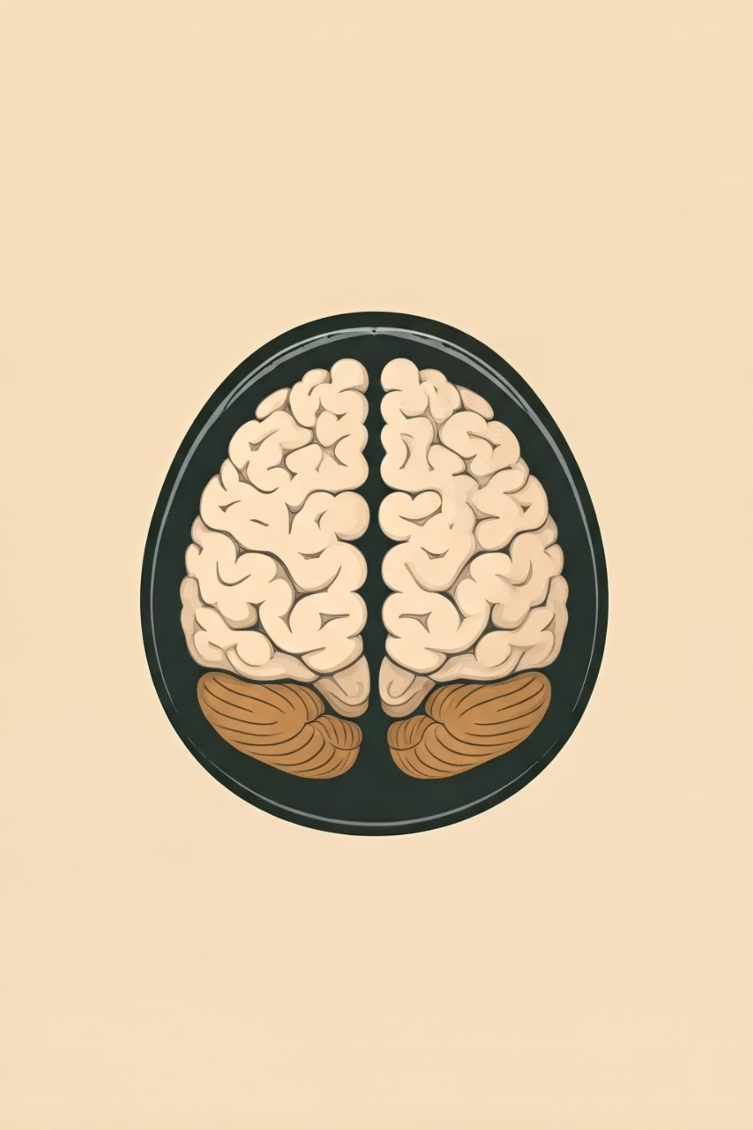


M.Tech/MCA Program
Advanced Industry Integrated Programs
Jointly offered by University and LTIMindTree
Review II
NeuroLens :
“Trusted AI for precision brain imaging.”
KUNAL MALLICK
KIIT (24167002)
Knowledge Partner:
Implementation Partner:

Slide 2
NeuroLens:Trusted AI for precision brain imaging
Introduction
Brain tumor segmentation is vital for diagnosis and treatment planning.
Existing models (U-Net, TransUNet, nnU-Net, Swin-Unet, etc.) show serious weaknesses.
We propose a comprehensive product that improves accuracy, speed, robustness, interpretability, and privacy.

Slide 3
NeuroLens:Trusted AI for precision brain imaging
Objectives
Build a lightweight hybrid CNN–Transformer model.
Improve generalization across multi-modal, multi-institution datasets.
Add explainability (heatmaps, uncertainty maps).
Enable privacy-preserving federated learning.
Deliver a fast, accurate, secure, and trustworthy solution.

Slide 4
NeuroLens:Trusted AI for precision brain imaging
Common Problems in Existing Models
1. High Computational Cost
Large parameter counts, heavy GPUs required, slow inference(TransUNet, Swin-Unet, UNETR, BSAU-Net, Mixed-FedUNet).
2. Dependence on Large Datasets
Transformers struggle with small medical datasets(TransUNet, MedT, Swin-Unet).
3. Limited Generalization
Many models trained only on BraTS, weak on unseen hospital data(BSAU-Net, Mixed-FedUNet, GDacFormer).
4. Accuracy vs Speed Trade-off
Attention models improve accuracy but double inference time(Swin-Unet, TransUNet).
5. Weak Transfer Learning
ImageNet pretraining brings little benefit for medical images(Swin-Unet, UNETR).

Slide 5
NeuroLens:Trusted AI for precision brain imaging
Common Problems in Existing Models
6. Training Instability & Complexity
GANs/Transformers need careful tuning, hard to reproduce(GDacFormer, nnFormer, Mixed-FedUNet).
7. Robustness Issues
Sensitive to initialization, normalization, and dataset variability(3D U-Net with BatchNorm, CAE+K-means).
8. Privacy & Security Risks
Federated learning still faces gradient leakage, model inversion attacks(FedHG, Mixed-FedUNet).
9. Lack of Interpretability
Many models act as “black boxes,” limiting clinical trust(CAE-based, Transformer-based).
10. Inherent Imaging Challenges
Tumors are small, irregular, and vary widely → imperfect Dice scores even in SOTA models(GDacFormer, nnFormer).

Slide 6
NeuroLens:Trusted AI for precision brain imaging
Role of Baseline Model
Baseline: 3D U-Net / nnU-Net
Role:
Validates pipeline (data → training → metrics).
Provides benchmark Dice score & inference time.
Acts as control experiment to prove improvements.
Clinical fallback if advanced models fail.

Slide 7
NeuroLens:Trusted AI for precision brain imaging
Clinical vs Research Models
Aspect | Clinical Model | Research Model
Goal | Fast, explainable, real-time | Maximum accuracy & robustness
Design | Lightweight CNN+Transformer (Swin-Tiny, ConvNeXt) | Full-scale CNN+Transformer (nnFormer variant)
Features | Pruning, quantization, early-exit | Multi-scale attention, ensemble, advanced post-processing
Priority | Speed + Interpretability | Dice Score + Robustness
Deployment | Edge devices / hospital GPUs | Research GPUs / servers

Slide 8
NeuroLens:Trusted AI for precision brain imaging
Modules Name
Data Collection & Preprocessing (MRI scans: T1, T2, FLAIR).
Baseline Model Development (U-Net / nnU-Net).
Hybrid Model Design (CNN + Transformer fusion).
Explainability & Interpretability Module.
Federated Learning & Privacy Module.
Evaluation & Benchmarking (accuracy, inference time, robustness).

Slide 9
NeuroLens:Trusted AI for precision brain imaging
Methodology / Modeling Plan
Phase 1 (Sept 25–29) : Setup + baseline U-Net
Phase 2 (Sept 30–Oct 8) : Hybrid model development
Phase 3 (Oct 9–15): Explainability + federated learning prototype
Phase 4 (Oct 16–22) : Testing & optimization
Phase 5 (Oct 23–30) : Final demo & report

Slide 10
NeuroLens:Trusted AI for precision brain imaging
Data Preprocessing & EDA
Dataset : BraTS 2020/2021 (+ external MRI dataset for generalization).
Preprocessing :
Intensity normalization
Resampling
Augmentation (rotation, flips, intensity shifts)
EDA : Tumor volume distribution, modality importance, variation in tumor sizes.

Slide 11
NeuroLens:Trusted AI for precision brain imaging
Approach / Algorithms / Tools
Baseline : 3D U-Net / nnU-Net.
Proposed : Hybrid CNN–Transformer (ConvNeXt + Swin blocks).
Explainability : Attention heatmaps, uncertainty estimation.
Privacy : Federated Learning + Differential Privacy.
Tools : Git, DVC, Docker, TensorBoard.

Slide 12

NeuroLens:Trusted AI for precision brain imaging
Project Plan / Milestones / Progress
Phase 1 : Setup & baseline model (Sept 25–29)
Phase 2 : Hybrid model (Sept 30–Oct 8)
Phase 3 : Explainability + FL (Oct 9–15)
Phase 4 : Optimization & Testing (Oct 16–22)
Phase 5 : Final demo & report (Oct 23–30)

Slide 13
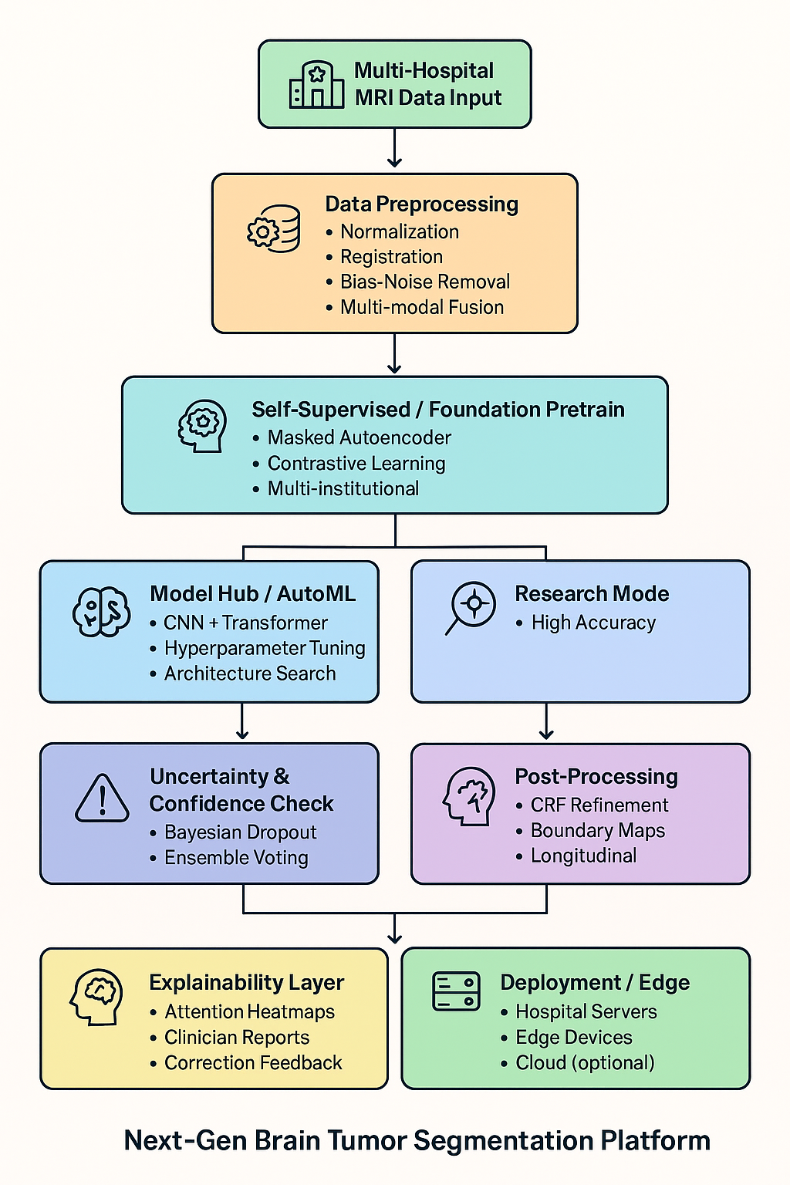
NeuroLens:Trusted AI for precision brain imaging
Pipeline Structure
Flow:
MRI Input → Preprocessing → Hybrid CNN–Transformer → Segmentation Map → Explainability (Heatmaps + Uncertainty) → Clinician Output
Federated Loop for multi-institution learning.

Slide 14
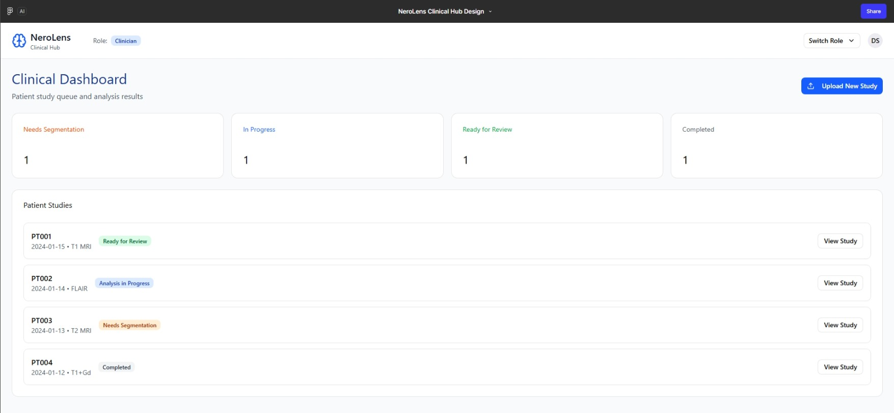
NeuroLens:Trusted AI for precision brain imaging
Clinical Dashboard (UI Prototype)

Slide 15
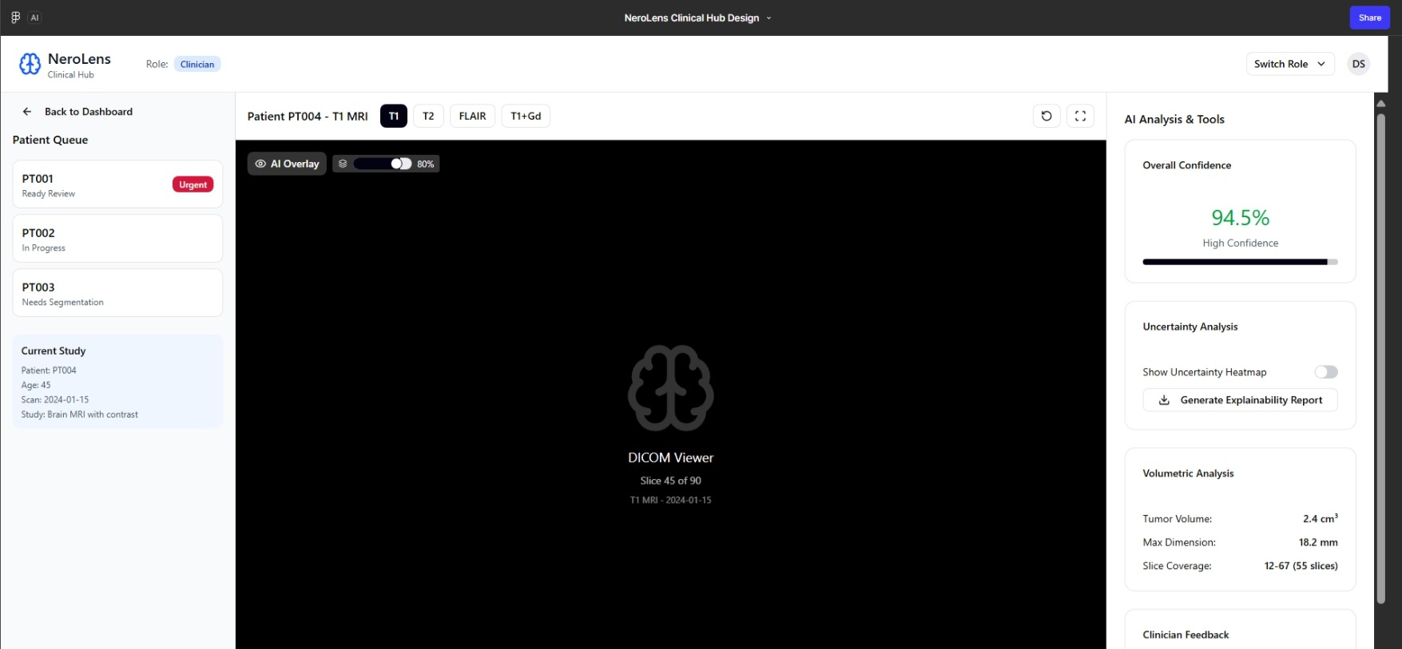
NeuroLens:Trusted AI for precision brain imaging
AI Analysis & Tools (UI Prototype)

Slide 16
NeuroLens:Trusted AI for precision brain imaging
Conclusion
Designed to solve top 10 weaknesses of existing models.
Dual mode: Clinical (fast, explainable) + Research (accurate, robust).
Final deliverables:
Optimized hybrid segmentation model
Explainability + federated learning
Benchmarks vs baseline U-Net
Demo pipeline for clinicians

Slide 17
NeuroLens:Trusted AI for precision brain imaging
References
MICCAI 2015
MICCAI 2016
MIDL 2018
No New-Net
TransUNet
ECCV 2022 (Workshop)
Medical Image Analysis, 2018
nnFormer
UNETR
SegFormer
Medical Transformer
Attention mechanism
Federated learning algorithm
Federated learning with integrated attention
Generative adversarial DacFormer network

